Slide 1
Chapter 8: Deadlocks

Slide 2
Chapter 8: Deadlocks
Deadlock Examples
Deadlock Characterization
Resource Allocation Graph
Methods for Handling Deadlocks
Deadlock Prevention
Deadlock Avoidance
Deadlock Detection and Recovery from Deadlock

Slide 3
Chapter Objectives
Illustrate how deadlock can occur when mutex locks are used.
Define the four necessary conditions that characterize deadlock.
Identify a deadlock situation in a resource allocation graph.
Evaluate the four different approaches for preventing deadlocks.
Apply banker’s algorithm for deadlock avoidance.
Apply the deadlock detection algorithm.
Evaluate approaches for recovering from deadlock.

Slide 4
Deadlock in Multithreaded Application
The order in which the threads run depends on how they are scheduled by the CPU scheduler
This example illustrates the fact that it is difficult to identify and test for deadlocks that may occur only under certain scheduling circumstances.

Slide 5
Deadlock Example with Lock Ordering
void transaction(Account from, Account to, double amount)
{
mutex lock1, lock2;
lock1 = get_lock(from);
lock2 = get_lock(to);
acquire(lock1);
acquire(lock2);
withdraw(from, amount);
deposit(to, amount);
release(lock2);
release(lock1);
}
Transactions 1 and 2 execute concurrently. Transaction 1 transfers $25 from account A to account B, and Transaction 2 transfers $50 from account B to account A

Slide 6
System Model
System consists of resources
Resource types R₁, R₂, . . ., R_{m}
CPU cycles, memory space, files, I/O devices
Each resource type R_{i} has W_{i} instances.
Each process P_{i} utilizes a resource as follows:
request
use
release

Slide 7
Deadlock Characterization
Deadlock involving multiple processes can arise if the following four conditions hold simultaneously – they are necessary but not sufficient conditions
Mutual exclusion: only one process at a time can use a resource
Hold and wait: a process holding at least one resource is waiting to acquire additional resource(s) held by other processes
No preemption: a resource can be released only voluntarily by the process holding it, after that process has completed its task
Circular wait: there exists a set {P₀, P₁, …, P_{n}} of waiting processes such that P₀ is waiting for a resource that is held by P₁, P₁ is waiting for a resource that is held by P₂, …, P_{n–1} is waiting for a resource that is held by P_{n}, and P_{n} is waiting for a resource that is held by P₀.

Slide 8
Resource-Allocation Graph
A set of vertices V and a set of edges E.
V is partitioned into two types:
P = {P₁, P₂, …, P_{n}}, the set consisting of all the processes in the system
R = {R₁, R₂, …, R_{m}}, the set consisting of all resource types in the system
request edge – directed edge P_{i} → R_{j}
assignment edge – directed edge R_{j} → P_{i}

Slide 9
Resource-Allocation Graph (Cont.)
Process
Resource Type with 4 instances
P_{i} requests instance of R_{j}
P_{i} is holding an instance of R_{j}
P_{i}
R_{j}
P_{i}
R_{j}

Slide 10
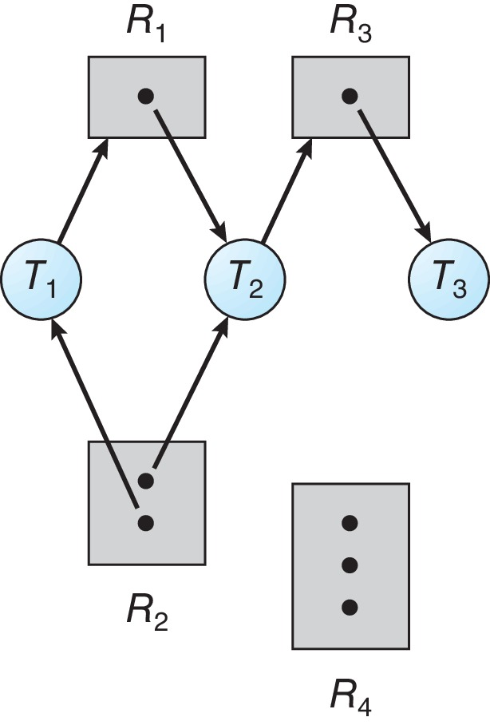
Resource Allocation Graph Example
One instance of R1
Two instances of R2
One instance of R3
Three instance of R4
T1 holds one instance of R2 and is waiting for an instance of R1
T2 holds one instance of R1, one instance of R2, and is waiting for an instance of R3
T3 is holds one instance of R3

Slide 11
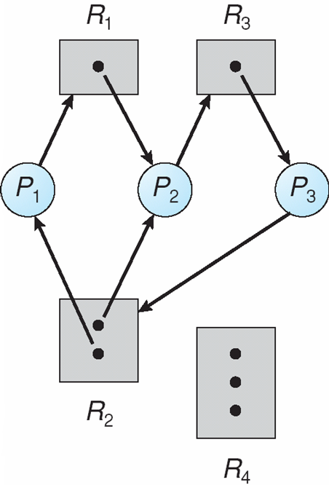
Resource Allocation Graph With A Deadlock
Cycles exist
P1 → R1 → P2 → R3 → P3 → R2 → P1
P2 → R3 → P3 → R2 → P2
Processes P1, P2, and P3 are deadlocked

Slide 12
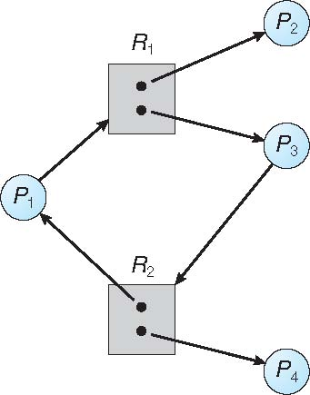
Graph With A Cycle But No Deadlock
A cycle exists
P1 → R1 → P3 → R2 → P1
However, there is no deadlock. Observe that thread P4 may release its instance of resource type R2. That resource can then be allocated to P3, breaking the cycle.

Slide 13
Basic Facts
If a graph contains no cycles ⇒ no deadlock
If a graph contains a cycle ⇒ the system may or may not be in a deadlocked state
if only one instance per resource type, then deadlock
if several instances per resource type, possibility of deadlock

Slide 14
Methods for Handling Deadlocks
Ensure that the system will never enter a deadlock state:
Deadlock prevention: it provides a set of methods to ensure at least one of the necessary conditions cannot hold
Deadlock avoidance: this requires additional information given in advance concerning which resources a process will request and use during its lifetime. Within such knowledge, the OS can decide for each resource request whether or not a process should wait
Deadlock detection - allow the system to enter a deadlock state， periodically detect if there is a deadlock and then recover from it
Many commercial OSes, esp., for desktops, laptops, and smart phones ignore the deadlock problem because of the overhead and pretend that deadlocks never occur in the system
It will cause the system’s performance to deteriorate, because resources are being held by processes that cannot run and because more and more processes, as they make requests for resources, will enter a deadlocked state – restart the system manually

Slide 15
Deadlock Prevention
Restrain the ways request can be made
Mutual Exclusion – not required for sharable resources (e.g., read-only files); but it must hold for non-sharable resources
Hold and Wait – must guarantee that whenever a process requests a resource, it does not hold any other resources
Require each process to request and be allocated all its resources before it begins execution, or request resources only when the process has none
The disadvantages - low resource utilization, and possible starvation
No Preemption –
If a process that is holding some resources requests another that cannot be immediately allocated to it, then all resources currently being held are released
Preempted resources added to list of resources for which the process is waiting
Process will be restarted only when it can regain its old resources, as well as the new ones that it is requesting
This can only be applied to resources whose state can be easily saved and restored such as registers, memory space and database transactions. It cannot generally be applied to resources such as locks and semaphores

Slide 16
Deadlock Prevention (Cont.)
Circular Wait – impose a total ordering of all resource types, and require that each process requests resources in an increasing order of enumeration – R = {<R₁, R₂, …, R_{m}>}
This requires that a process cannot request a resource R_{j} before requesting a resource R_{i} if j > i
This can be proved by contradiction
Let the set of processes involved in a circular wait be P = {<P₀, P₁, …, P_{n}>}, where P_{i} is waiting for a resource R_{i}, which is held by process P_{i+1}, so that P_{n} is waiting for a resource R_{n} held by P₀ .
Since process P_{i+1} is holding resource R_{i} while requesting resource R_{i+1}, we must have R_{i} < R_{i+1} for all i.
This implies R₀ < R₁ < R₂ … < R_{n} < R₀
R₀ < R₀, this is impossible, therefore there can be no circular wait

Slide 17
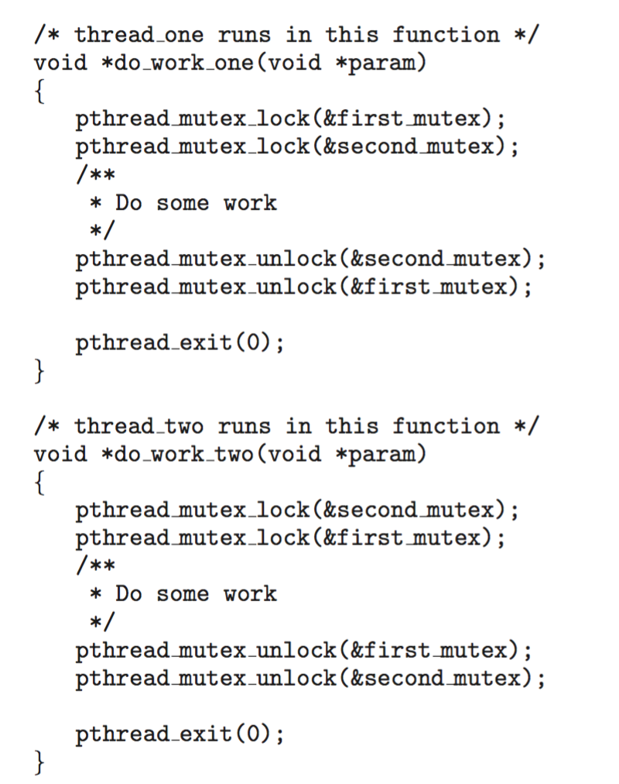
Circular Wait
Invalidating the circular wait condition is most common.
Simply assign each resource (i.e. mutex locks) a unique number.
Resources must be acquired in order.
If: first_mutex = 1 second_mutex = 5 code for thread_two could not be written as follows:

Slide 18
Deadlock Avoidance
Requires that the system has some additional a priori information available
For instance, with the knowledge of complete sequence of requests and releases for each process, the system can decide for each request whether or not the process should wait in order to avoid a possible future deadlock.
The simplest and most useful model requires that each process declares the maximum number of resources of each type that it may need
The deadlock-avoidance algorithm dynamically examines the resource-allocation state to ensure that a circular-wait condition can never exist
Resource-allocation state is defined by the number of available and allocated resources, and the maximum demands of the processes

Slide 19
Safe State
When a process requests an available resource, system must decide whether such an allocation leaves the system in a safe state
System is in safe state if there exists a sequence <P₁, P₂, …, P_{n}> consisting of all processes in the systems such that for each P_{i}, the resources that P_{i} can still request (based on prior declaration) can be satisfied by currently available resources plus resources held by all P_{j}, with j < i. That is:
If P_{i} resource needs are not immediately available, then P_{i} can wait until all P_{j} have finished
When P_{j} is finished, P_{i} can obtain needed resources, execute, return allocated resources, and terminate
When P_{i} terminates, P_{i +1} can obtain its needed resources, and so on
If no such sequence exists, then the system state is said to be unsafe.

Slide 20
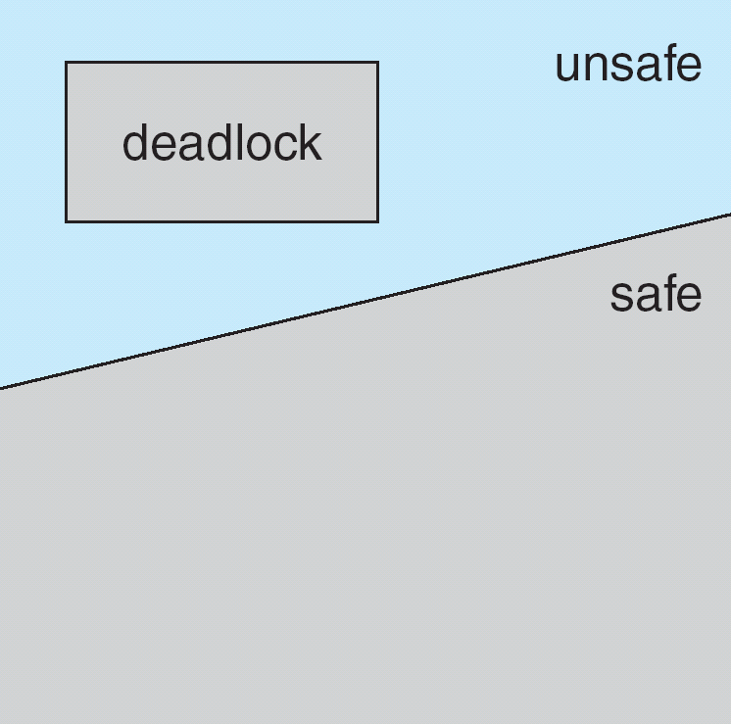
Basic Facts
If a system is in safe state ⇒ no deadlocks
If a system is in unsafe state ⇒ possibility of deadlock
Avoidance ⇒ ensure that a system will never enter an unsafe state
In this scheme, if a process requests a resource that is currently available, it may still have to wait (if the allocation leads to unsafe state).
The resource utilization may be lower than it would be otherwise

Slide 21
Avoidance algorithms
Single instance of a resource type
Use a resource-allocation graph
Multiple instances of a resource type
Use the banker’s algorithm

Slide 22
Resource-Allocation Graph Scheme
Claim edge P_{i} → R_{j} indicates that process P_{j} may request resource R_{j}; represented by a dashed line
Claim edge converts to request edge when a process requests a resource
Request edge converts to an assignment edge when the resource is allocated to the process
When a resource is released by a process, assignment edge reconverts to claim edge
Resources must be claimed a priori in the system

Slide 23
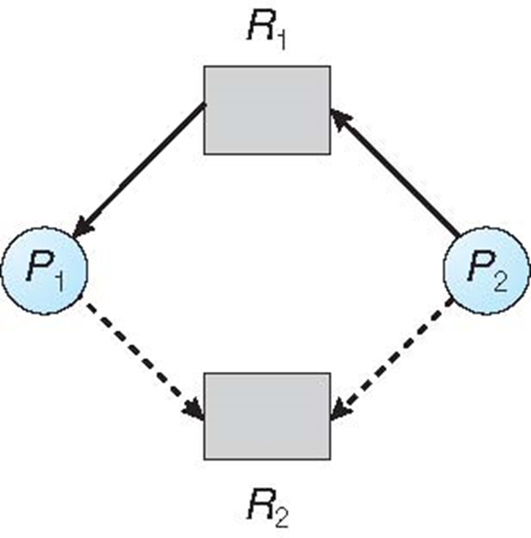
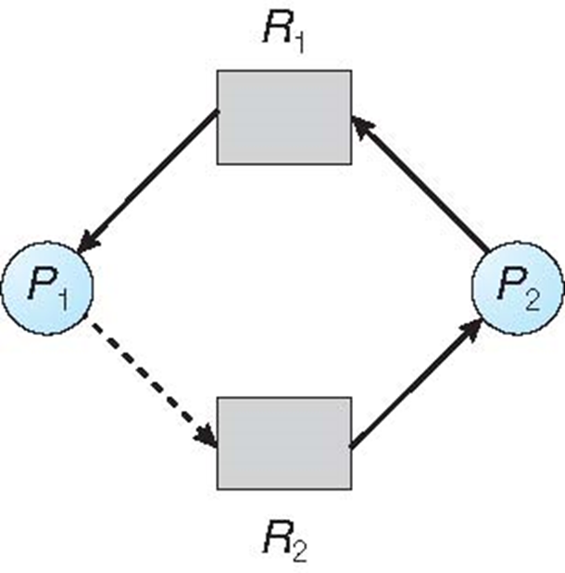
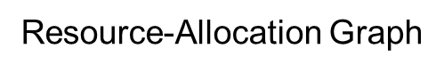
Resource-Allocation Graph Algorithm
Suppose that process P_{i} requests a resource R_{j}
The request can be granted only if converting the request edge to an assignment edge does not result in the formation of a cycle in the resource allocation graph

Slide 24
Banker’s Algorithm
Multiple instances
Each process must declare a priori maximum usage
When a process requests a resource it may have to wait – check to see if this allocation results in a safe state or not
When a process gets all its resources it must return them in a finite amount of time after use
This is analogous to banking load system, which has a maximum amount, total, that can be loaned at one time to a set of businesses each with a credit line.

Slide 25
Data Structures for the Banker’s Algorithm
Let n = number of processes, and m = number of resources types.
Available: Vector of length m. If available [j] = k, there are k instances of resource type R_{j} available
Max: n x m matrix. If Max [i,j] = k, then process P_{i} may request at most k instances of resource type R_{j}
Allocation: n x m matrix. If Allocation[i,j] = k then P_{i} is currently allocated k instances of R_{j}
Need: n x m matrix. If Need[i,j] = k, then P_{i} may need k more instances of R_{j} to complete its task
Need [i,j] = Max[i,j] – Allocation [i,j]

Slide 26
Safety Algorithm
1. Let Work and Finish be vectors of length m and n, respectively. Initialize:
Work = Available
Finish [i] = false for i = 0, 1, …, n- 1
2. Find an i such that both:
(a) Finish [i] = false
(b) Need_{i} ≤ Work
If no such i exists, go to step 4
3. Work = Work + Allocation_{i} Finish[i] = true go to step 2
4. If Finish [i] == true for all i, then the system is in a safe state, otherwise unsafe

Slide 27
Resource-Request Algorithm for Process P_{i}
Request = request vector for process P_{i}. If Request_{i} [j] = k then process P_{i} wants k instances of resource type R_{j}
If Request_{i} ≤ Need_{i} go to step 2. Otherwise, raise error condition, since process has exceeded its maximum claim
If Request_{i} ≤ Available, go to step 3. Otherwise P_{i} must wait, since resources are not available
Pretend to have allocated requested resources to P_{i} by modifying the state as follows:
Available = Available – Request;
Allocation_{i} = Allocation_{i} + Request_{i};
Need_{i} = Need_{i} – Request_{i};
Run safety algorithm: If safe ⇒ the resources can be allocated to P_{i}
If unsafe ⇒ P_{i} must wait, and the old resource-allocation state is restored

Slide 28
Example of Banker’s Algorithm
5 processes P₀ through P₄;
3 resource types:
A (10 instances), B (5 instances), and C (7 instances)
Snapshot at time T₀:
Allocation Max Available
A B C A B C A B C
P₀ 0 1 0 7 5 3 3 3 2
P₁ 2 0 0 3 2 2
P₂ 3 0 2 9 0 2
P₃ 2 1 1 2 2 2
P₄ 0 0 2 4 3 3

Slide 29
Example (Cont.)
The content of the matrix Need is defined to be Max – Allocation
Need
A B C
P₀ 7 4 3
P₁ 1 2 2
P₂ 6 0 0
P₃ 0 1 1
P₄ 4 3 1
The system is in a safe state since the sequence < P₁, P₃, P₄, P₂, P₀> satisfies the safety criteria

Slide 30
Example (Cont.)
5 processes P₀ through P₄; 3 resource types:
A (10 instances), B (5 instances), and C (7 instances)
Snapshot at time T₀:
Allocation Max Available Need
A B C A B C A B C A B C
P₀ 0 1 0 7 5 3 3 3 2 7 4 3
P₁ 2 0 0 3 2 2 1 2 2
P₂ 3 0 2 9 0 2 6 0 0
P₃ 2 1 1 2 2 2 0 1 1
P₄ 0 0 2 4 3 3 4 3 1
The system is in a safe state since the sequence < P₁, P₃, P₄, P₂, P₀> satisfies the safety criteria

Slide 31
Example: P₁ Request (1,0,2)
Check that Request ≤ Available, that is, (1,0,2) ≤ (3,3,2) ⇒ true
Allocation Need Available
A B C A B C A B C
P₀ 0 1 0 7 4 3 2 3 0
P₁ 3 0 2 0 2 0
P₂ 3 0 2 6 0 0
P₃ 2 1 1 0 1 1
P₄ 0 0 2 4 3 1
Executing safety algorithm shows that sequence < P₁, P₃, P₄, P₀, P₂> satisfies safety requirement
Can request for (3,3,0) by P₄ be granted? – resource not available
Can request for (0,2,0) by P₀ be granted? – state is not safe

Slide 32
Deadlock Detection
If a system does not use either a deadlock-prevention, or deadlock-avoidance algorithm, then a deadlock situation may occur. In this environment, the system may provide
An algorithm that examines the state of the system to determine whether a deadlock can occur
An algorithm to recover from the deadlock

Slide 33
Single Instance of Each Resource Type
Maintain wait-for graph
Nodes are processes
P_{i} → P_{j} if P_{i} is waiting for P_{j}
Periodically invoke an algorithm that searches for a cycle in the graph. If there is a cycle, there exists a deadlock
An algorithm to detect a cycle in a graph requires an order of n² operations, where n is the number of vertices in the graph
The wait-for graph scheme is not applicable to a resource-allocation system with multiple instances for each resource type

Slide 34
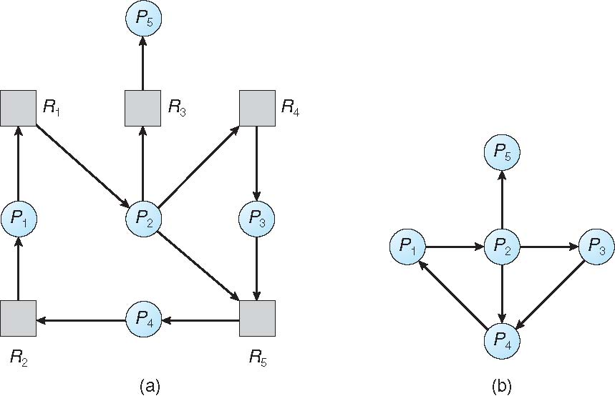
Resource-Allocation Graph and Wait-for Graph
Resource-Allocation Graph
Corresponding Wait-for Graph

Slide 35
Several Instances for a Resource Type
Available: A vector of length m indicates the number of available resources of each type
Allocation: An n x m matrix defines the number of resources of each type currently allocated to each process
Request: An n x m matrix indicates the current request of each process. If Request [i][j] = k, then process P_{i} is requesting k instances of resource type R_{j}.

Slide 36
Detection Algorithm
1. Let Work and Finish be vectors of length m and n, respectively Initialize:
(a) Work = Available
(b) For i = 1,2, …, n, if Allocation_{i} ≠ 0, then Finish[i] = false; otherwise, Finish[i] = true
2. Find an index i such that both:
(a) Finish[i] == false
(b) Request_{i} ≤ Work
If no such i exists, go to step 4
3. Work = Work + Allocation_{i} Finish[i] = true go to step 2
4. If Finish[i] == false, for some i, 1 ≤ i ≤ n, then the system is in deadlock state. Moreover, if Finish[i] == false, then P_{i} is deadlocked
This algorithm requires an order of O(m x n²) operations to detect whether the system is in deadlocked state

Slide 37
Example of Detection Algorithm
Five processes P₀ through P₄; three resource types A (7 instances), B (2 instances), and C (6 instances)
Snapshot at time T₀:
Allocation Request Available
A B C A B C A B C
P₀ 0 1 0 0 0 0 0 0 0
P₁ 2 0 0 2 0 2
P₂ 3 0 3 0 0 0
P₃ 2 1 1 1 0 0
P₄ 0 0 2 0 0 2
Sequence <P₀, P₂, P₃, P₁, P₄> will result in Finish[i] = true for all i

Slide 38
Example (Cont.)
P₂ requests an additional instance of type C
Request
A B C
P₀ 0 0 0
P₁ 2 0 2
P₂ 0 0 1
P₃ 1 0 0
P₄ 0 0 2
State of system?
Can reclaim resources held by process P₀, but insufficient resources to fulfill other processes; requests
Deadlock exists, consisting of processes P₁, P₂, P₃, and P₄

Slide 39
Detection-Algorithm Usage
When, and how often, to invoke depends on:
How often a deadlock is likely to occur?
How many processes will be affected by a deadlock when it occurs
one for each disjoint cycle
If detection algorithm is invoked arbitrarily, there may be many cycles in the resource graph; we would not be able to tell which of the many deadlocked processes “caused” the deadlock.
Invoking the deadlock detection algorithm for every resource request will incur considerable overhead in computation.
A less expensive alternative is to invoke the algorithm at defined intervals – for example, once per hour, or whenever CPU utilization drops below 40%

Slide 40
Recovery from Deadlock: Process Termination
Abort all deadlocked processes: This clearly breaks the deadlock cycle, but at great expense
Abort one process at a time until the deadlock cycle is eliminated: This incurs considerable overhead, since after each process is aborted, the deadlock-detection algorithm needs to run
In which order should we choose to abort? – many factors:
Priority of the process
How long process has computed, and how much longer to complete?
Resources the process has used
Resources the process needs to complete
How many processes will need to be terminated?
Is process interactive or batch?

Slide 41
Recovery from Deadlock: Resource Preemption
To successively preempt some resources from processes and give these resources to other processes until the deadlock cycle is broken
Selecting a victim – minimize cost (which resources and which processes are to be preempted)
Rollback – return to some safe state, restart process from that state
Starvation – the same process may always be picked as victim, including the number of rollback in cost factor might help to reduce the starvation

Slide 42
End of Chapter 8

